Slide 1
2014 – 2015 Soccer Uniform Requirements
Socks – Home: SOLID WHITE, Away: PREDOMINANTLY DARK
*Tape, if used, must be of similar color to the sock color.
Jerseys – Home: SOLID WHITE, Away: PREDOMINANTLY DARK
4” # on the front (or on front of short), 6” # on the back.
ONE manufacturer’s logo may be visible (2 ¼ sq “ max)
Shorts – NO color restrictions, Home or Away. May be numbered on the front leg (4”) as opposed to numbering the FRONT of the jersey (4”).

Slide 2
Required Equipment Rule 4-1-1c
PlayPic®
PlayPic®
The home team shall wear solid white jerseys and solid white socks, with shorts of any color. If tape or similar material is applied on any sock, it must be similar in color to the socks to which it is applied.
The color of the tape, if used, must be the same/similar color as the sock.
Notes:
RULE 4-1-1c – REQUIRED EQUIPMENT
ART. 1 . . . The required player equipment includes a jersey, shorts, socks, suitable shoes and shinguards. The shinguards shall provide adequate and reasonable protection, be professionally manufactured, age- and size-appropriate, not altered to decrease protection, worn under the socks, and are worn with the bottom edge no higher than 2 inches above the ankle. (see illustrations regarding shinguards). Shinguards must meet the National Operating Committee on Standards for Athletic Equipment (NOCSAE) specifications. The NOCSAE seal and height range shall be permanently marked on the front of the shinguard. Equipment shall not be modified from its original manufactured state and shall be worn in the manner the manufacturer intended it to be worn. It is also recommended that male players wear a supporter and protective cup. Requirements for uniforms:
a. Jerseys and socks of opposing teams shall be of contrasting colors and, in the event of a similarity of color; the home team shall be responsible for making the necessary change.
b. The home team shall wear solid white jerseys and solid white socks, and the visiting team shall wear dark jerseys and socks. Prior to and during the game, jerseys shall be tucked into the shorts, unless manufactured to be worn outside.
c. Both socks shall be the same color, with the home team wearing solid white socks and the visiting team wearing socks of a single dominant color, but not necessarily the color of the jersey. If tape of similar material is applied externally to the socks, it must be of similar color as that part of the sock to which it is applied.

Slide 3
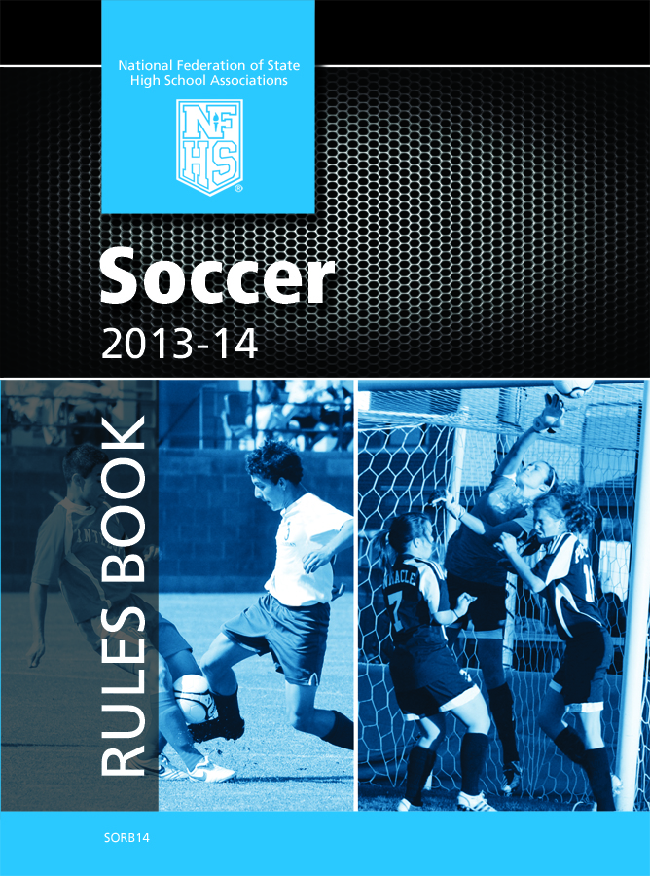
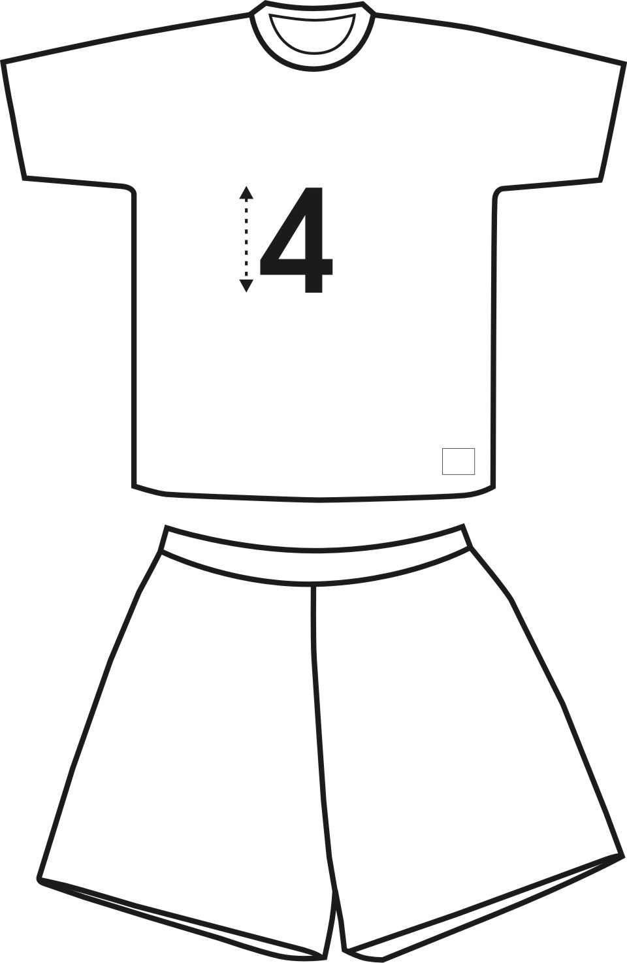
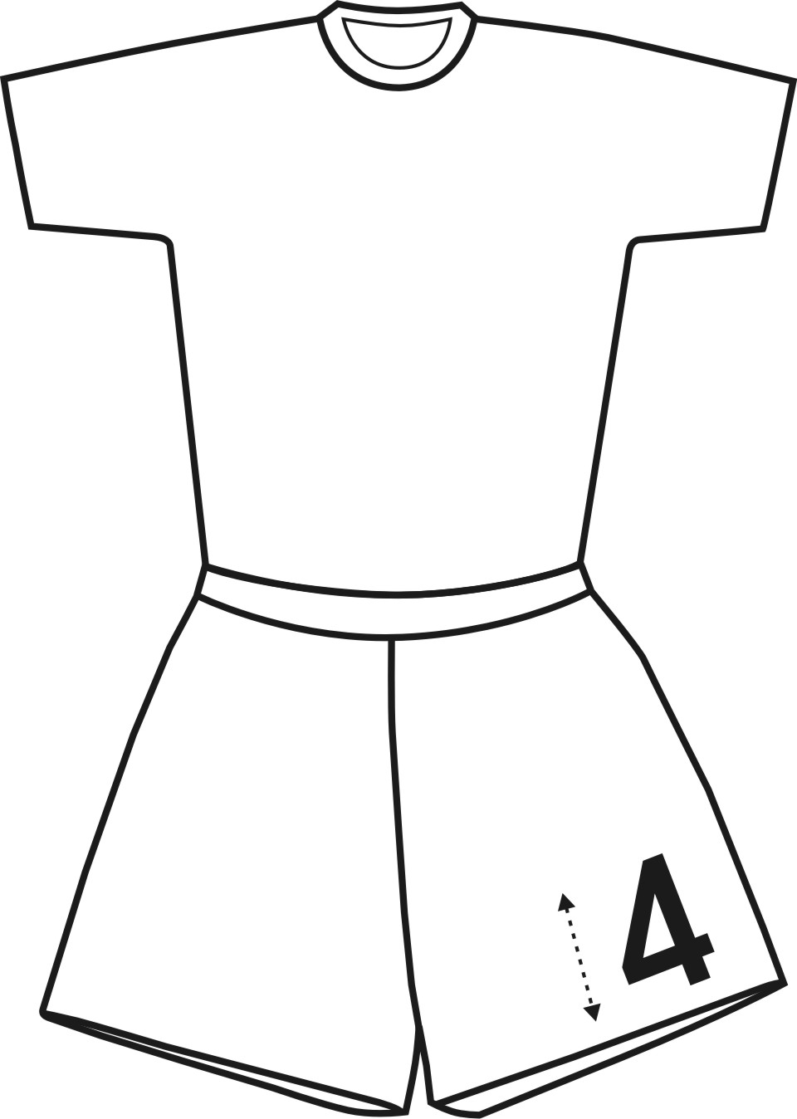
Current Team Uniform Requirements Front
Front of Uniform Options
All jersey’s shall be numbered on the front with a different Arabic number at least 4 inches in height
This number must be placed on the jersey or short
1 manufacturer’s logo
2¼ square inches is permitted on each item (visible anywhere on the uniform)
Page: 24
Home team shall wear white jerseys and socks
Visiting team shall wear dark jerseys and socks
Notes:
RULE 4-1-1b – REQUIRED EQUIPMENT
ART. 1 . . . The required player equipment includes a jersey, shorts, socks, suitable shoes and shinguards. The shinguards shall provide adequate and reasonable protection, be professionally manufactured, age- and size-appropriate, not altered to decrease protection, worn under the socks, and are worn with the bottom edge no higher than 2 inches above the ankle. (see illustrations regarding shinguards). Shinguards must meet the National Operating Committee on Standards for Athletic Equipment (NOCSAE) specifications. The NOCSAE seal and height range shall be permanently marked on the front of the shinguard. Equipment shall not be modified from its original manufactured state and shall be worn in the manner the manufacturer intended it to be worn. It is also recommended that male players wear a supporter and protective cup. Requirements for uniforms:
a. Jerseys and socks of opposing teams shall be of contrasting colors and, in the event of a similarity of color; the home team shall be responsible for making the necessary change.
b. The home team shall wear solid white jerseys and solid white socks, and the visiting team shall wear dark jerseys and socks. Prior to and during the game, jerseys shall be tucked into the shorts, unless manufactured to be worn outside.
c. Both socks shall be the same color, with the home team wearing solid white socks and the visiting team wearing socks of a single dominant color, but not necessarily the color of the jersey. If tape of similar material is applied externally to the socks, it must be of similar color as that part of the sock to which it is applied.
d. A manufacturer's logo/trademark appearing on both sides of the socks is legal.
e. If visible apparel is worn under the jersey and/or shorts, it shall be of a similar length, all alike and of a solid color.
f. One manufacturer's logo/trademark or reference is permitted on the outside of each item which may not exceed 2¼ square inches and may not exceed 2¼ inches in any dimension. (Subject to the provisions in 4-1-1(d))
g. An American flag, not to exceed 2 by 3 inches, and either a commemorative or memorial patch, not to exceed 4 square inches and with written state association approval, may be worn on the jersey provided neither the flag nor the patch interferes with the visibility of the number.
h. When an illegally uniformed team is unable to correct the situation or cannot verify state association approval of the uniform, the game shall be played. The referee must, however, notify the state association following the game.
i. Except for the uniform of the goalkeeper, jerseys, shorts and socks of teammates shall be of similar color, design and pattern.
1. All jerseys, shall be numbered on the back with a different Arabic number at least 6 inches in height and on the front (jersey or shorts) with the same number, which shall be at least 4 inches in height. Numbers shall be of contrasting color to the jersey (or shorts) and clearly visible.
2. Only those names, patches, emblems, logos or insignias referencing the school are permitted on the team uniform, except as in 4-1-1 (d), (f) and (g). The player's name may also appear on the team uniform.
3. The jersey of the goalkeeper shall be distinctly different from that of any teammate or opponent, except the other goalkeeper. The shorts or pants and socks of the goalkeeper are not required to be the same color as his/her teammates, but must comply with Rule 4-1-1f.
j. Shoes must be worn by all participants in a game. Shoes with soles containing metal (aluminum, magnesium, titanium, etc.), leather, rubber, nylon, or plastic cleats, studs, or bars, whether molded as part of the sole or detachable, are allowed as long as the referee does not consider them dangerous or they have been altered in any way creating sharp edges thus rendering them unsafe.

Slide 4
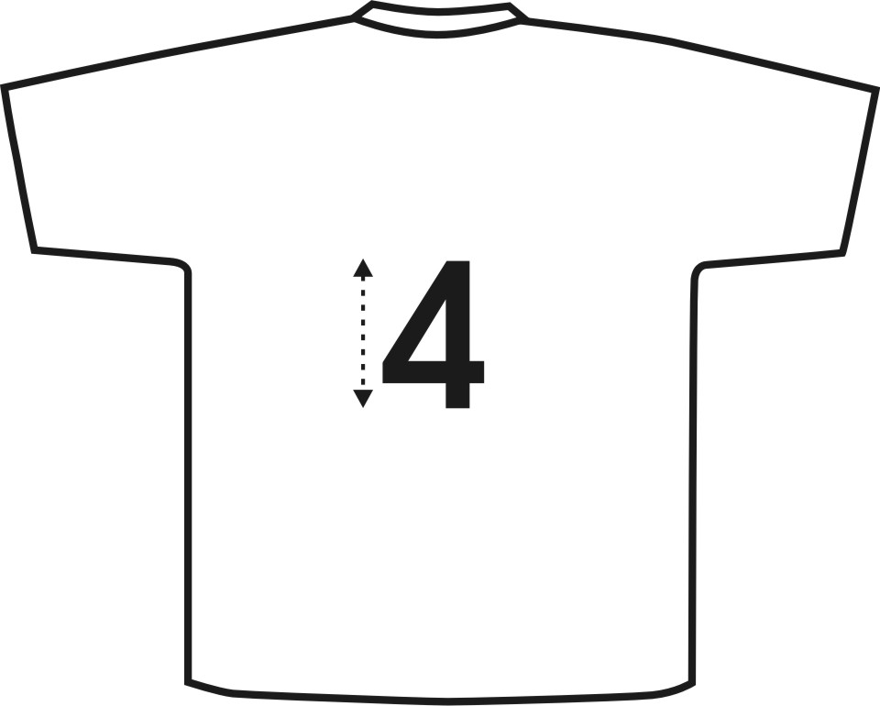
Current Team Uniform Requirements Back
Back of Uniform
All jersey’s shall be numbered on the back with a different Arabic number at least 6 inches in height
Page: 24
Shoes must be worn by all participants
Both socks shall be the same color, with the home team wearing solid white socks and the visiting team wearing socks of a single predominantly dark color, but not necessarily the color of the jersey
Notes:
RULE 4-1-1b – REQUIRED EQUIPMENT
ART. 1 . . . The required player equipment includes a jersey, shorts, socks, suitable shoes and shinguards. The shinguards shall provide adequate and reasonable protection, be professionally manufactured, age- and size-appropriate, not altered to decrease protection, worn under the socks, and are worn with the bottom edge no higher than 2 inches above the ankle. (see illustrations regarding shinguards). Shinguards must meet the National Operating Committee on Standards for Athletic Equipment (NOCSAE) specifications. The NOCSAE seal and height range shall be permanently marked on the front of the shinguard. Equipment shall not be modified from its original manufactured state and shall be worn in the manner the manufacturer intended it to be worn. It is also recommended that male players wear a supporter and protective cup. Requirements for uniforms:
a. Jerseys and socks of opposing teams shall be of contrasting colors and, in the event of a similarity of color; the home team shall be responsible for making the necessary change.
b. The home team shall wear solid white jerseys and solid white socks, and the visiting team shall wear dark jerseys and socks. Prior to and during the game, jerseys shall be tucked into the shorts, unless manufactured to be worn outside.
c. Both socks shall be the same color, with the home team wearing solid white socks and the visiting team wearing socks of a single dominant color, but not necessarily the color of the jersey. If tape of similar material is applied externally to the socks, it must be of similar color as that part of the sock to which it is applied.
d. A manufacturer's logo/trademark appearing on both sides of the socks is legal.
e. If visible apparel is worn under the jersey and/or shorts, it shall be of a similar length, all alike and of a solid color.
f. One manufacturer's logo/trademark or reference is permitted on the outside of each item which may not exceed 2¼ square inches and may not exceed 2¼ inches in any dimension. (Subject to the provisions in 4-1-1(d))
g. An American flag, not to exceed 2 by 3 inches, and either a commemorative or memorial patch, not to exceed 4 square inches and with written state association approval, may be worn on the jersey provided neither the flag nor the patch interferes with the visibility of the number.
h. When an illegally uniformed team is unable to correct the situation or cannot verify state association approval of the uniform, the game shall be played. The referee must, however, notify the state association following the game.
i. Except for the uniform of the goalkeeper, jerseys, shorts and socks of teammates shall be of similar color, design and pattern.
1. All jerseys, shall be numbered on the back with a different Arabic number at least 6 inches in height and on the front (jersey or shorts) with the same number, which shall be at least 4 inches in height. Numbers shall be of contrasting color to the jersey (or shorts) and clearly visible.
2. Only those names, patches, emblems, logos or insignias referencing the school are permitted on the team uniform, except as in 4-1-1 (d), (f) and (g). The player's name may also appear on the team uniform.
3. The jersey of the goalkeeper shall be distinctly different from that of any teammate or opponent, except the other goalkeeper. The shorts or pants and socks of the goalkeeper are not required to be the same color as his/her teammates, but must comply with Rule 4-1-1f.
j. Shoes must be worn by all participants in a game. Shoes with soles containing metal (aluminum, magnesium, titanium, etc.), leather, rubber, nylon, or plastic cleats, studs, or bars, whether molded as part of the sole or detachable, are allowed as long as the referee does not consider them dangerous or they have been altered in any way creating sharp edges thus rendering them unsafe.

Slide 5
EFFECTIVE 2013 FALL SEASON
Notes:
RULE 4-1-1b – REQUIRED EQUIPMENT
ART. 1 . . . The required player equipment includes a jersey, shorts, socks, suitable shoes and shinguards. The shinguards shall provide adequate and reasonable protection, be professionally manufactured, age- and size-appropriate, not altered to decrease protection, worn under the socks, and are worn with the bottom edge no higher than 2 inches above the ankle. (see illustrations regarding shinguards). Shinguards must meet the National Operating Committee on Standards for Athletic Equipment (NOCSAE) specifications. The NOCSAE seal and height range shall be permanently marked on the front of the shinguard. Equipment shall not be modified from its original manufactured state and shall be worn in the manner the manufacturer intended it to be worn. It is also recommended that male players wear a supporter and protective cup. Requirements for uniforms:
a. Jerseys and socks of opposing teams shall be of contrasting colors and, in the event of a similarity of color; the home team shall be responsible for making the necessary change.
b. The home team shall wear solid white jerseys and solid white socks, and the visiting team shall wear dark jerseys and socks. Prior to and during the game, jerseys shall be tucked into the shorts, unless manufactured to be worn outside.
c. Both socks shall be the same color, with the home team wearing solid white socks and the visiting team wearing socks of a single dominant color, but not necessarily the color of the jersey. If tape of similar material is applied externally to the socks, it must be of similar color as that part of the sock to which it is applied.
d. A manufacturer's logo/trademark appearing on both sides of the socks is legal.
e. If visible apparel is worn under the jersey and/or shorts, it shall be of a similar length, all alike and of a solid color.
f. One manufacturer's logo/trademark or reference is permitted on the outside of each item which may not exceed 2¼ square inches and may not exceed 2¼ inches in any dimension. (Subject to the provisions in 4-1-1(d))
g. An American flag, not to exceed 2 by 3 inches, and either a commemorative or memorial patch, not to exceed 4 square inches and with written state association approval, may be worn on the jersey provided neither the flag nor the patch interferes with the visibility of the number.
h. When an illegally uniformed team is unable to correct the situation or cannot verify state association approval of the uniform, the game shall be played. The referee must, however, notify the state association following the game.
i. Except for the uniform of the goalkeeper, jerseys, shorts and socks of teammates shall be of similar color, design and pattern.
1. All jerseys, shall be numbered on the back with a different Arabic number at least 6 inches in height and on the front (jersey or shorts) with the same number, which shall be at least 4 inches in height. Numbers shall be of contrasting color to the jersey (or shorts) and clearly visible.
2. Only those names, patches, emblems, logos or insignias referencing the school are permitted on the team uniform, except as in 4-1-1 (d), (f) and (g). The player's name may also appear on the team uniform.
3. The jersey of the goalkeeper shall be distinctly different from that of any teammate or opponent, except the other goalkeeper. The shorts or pants and socks of the goalkeeper are not required to be the same color as his/her teammates, but must comply with Rule 4-1-1f.
j. Shoes must be worn by all participants in a game. Shoes with soles containing metal (aluminum, magnesium, titanium, etc.), leather, rubber, nylon, or plastic cleats, studs, or bars, whether molded as part of the sole or detachable, are allowed as long as the referee does not consider them dangerous or they have been altered in any way creating sharp edges thus rendering them unsafe.

Slide 6
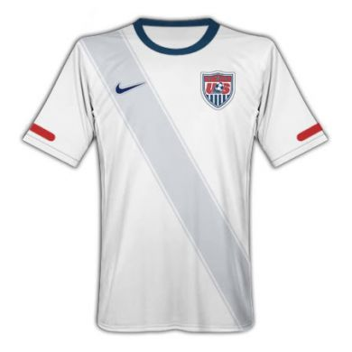
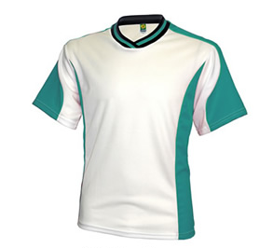
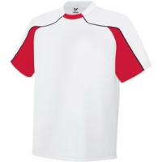
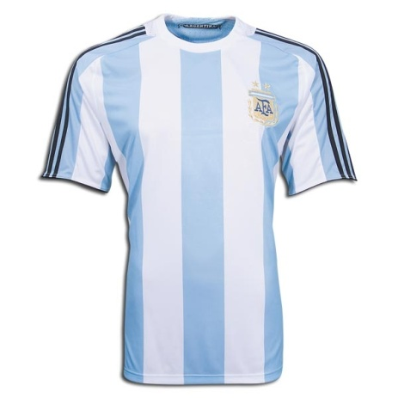
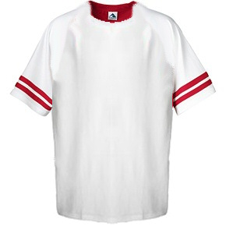
Illegal Home Team Jerseys
Color Side Panels and Color Piping
Notes:
RULE 4-1-1b – REQUIRED EQUIPMENT
ART. 1 . . . The required player equipment includes a jersey, shorts, socks, suitable shoes and shinguards. The shinguards shall provide adequate and reasonable protection, be professionally manufactured, age- and size-appropriate, not altered to decrease protection, worn under the socks, and are worn with the bottom edge no higher than 2 inches above the ankle. (see illustrations regarding shinguards). Shinguards must meet the National Operating Committee on Standards for Athletic Equipment (NOCSAE) specifications. The NOCSAE seal and height range shall be permanently marked on the front of the shinguard. Equipment shall not be modified from its original manufactured state and shall be worn in the manner the manufacturer intended it to be worn. It is also recommended that male players wear a supporter and protective cup. Requirements for uniforms:
a. Jerseys and socks of opposing teams shall be of contrasting colors and, in the event of a similarity of color; the home team shall be responsible for making the necessary change.
b. The home team shall wear solid white jerseys and solid white socks, and the visiting team shall wear dark jerseys and socks. Prior to and during the game, jerseys shall be tucked into the shorts, unless manufactured to be worn outside.
c. Both socks shall be the same color, with the home team wearing solid white socks and the visiting team wearing socks of a single dominant color, but not necessarily the color of the jersey. If tape of similar material is applied externally to the socks, it must be of similar color as that part of the sock to which it is applied.
d. A manufacturer's logo/trademark appearing on both sides of the socks is legal.
e. If visible apparel is worn under the jersey and/or shorts, it shall be of a similar length, all alike and of a solid color.
f. One manufacturer's logo/trademark or reference is permitted on the outside of each item which may not exceed 2¼ square inches and may not exceed 2¼ inches in any dimension. (Subject to the provisions in 4-1-1(d))
g. An American flag, not to exceed 2 by 3 inches, and either a commemorative or memorial patch, not to exceed 4 square inches and with written state association approval, may be worn on the jersey provided neither the flag nor the patch interferes with the visibility of the number.
h. When an illegally uniformed team is unable to correct the situation or cannot verify state association approval of the uniform, the game shall be played. The referee must, however, notify the state association following the game.
i. Except for the uniform of the goalkeeper, jerseys, shorts and socks of teammates shall be of similar color, design and pattern.
1. All jerseys, shall be numbered on the back with a different Arabic number at least 6 inches in height and on the front (jersey or shorts) with the same number, which shall be at least 4 inches in height. Numbers shall be of contrasting color to the jersey (or shorts) and clearly visible.
2. Only those names, patches, emblems, logos or insignias referencing the school are permitted on the team uniform, except as in 4-1-1 (d), (f) and (g). The player's name may also appear on the team uniform.
3. The jersey of the goalkeeper shall be distinctly different from that of any teammate or opponent, except the other goalkeeper. The shorts or pants and socks of the goalkeeper are not required to be the same color as his/her teammates, but must comply with Rule 4-1-1f.
j. Shoes must be worn by all participants in a game. Shoes with soles containing metal (aluminum, magnesium, titanium, etc.), leather, rubber, nylon, or plastic cleats, studs, or bars, whether molded as part of the sole or detachable, are allowed as long as the referee does not consider them dangerous or they have been altered in any way creating sharp edges thus rendering them unsafe.

Slide 7
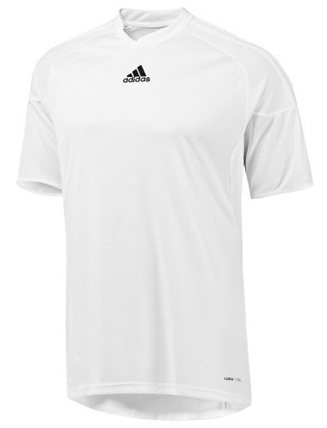
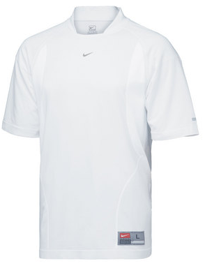
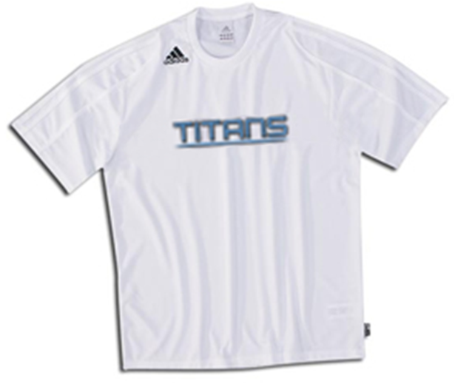
Legal Home Team Jerseys
Notes:
RULE 4-1-1b – REQUIRED EQUIPMENT
ART. 1 . . . The required player equipment includes a jersey, shorts, socks, suitable shoes and shinguards. The shinguards shall provide adequate and reasonable protection, be professionally manufactured, age- and size-appropriate, not altered to decrease protection, worn under the socks, and are worn with the bottom edge no higher than 2 inches above the ankle. (see illustrations regarding shinguards). Shinguards must meet the National Operating Committee on Standards for Athletic Equipment (NOCSAE) specifications. The NOCSAE seal and height range shall be permanently marked on the front of the shinguard. Equipment shall not be modified from its original manufactured state and shall be worn in the manner the manufacturer intended it to be worn. It is also recommended that male players wear a supporter and protective cup. Requirements for uniforms:
a. Jerseys and socks of opposing teams shall be of contrasting colors and, in the event of a similarity of color; the home team shall be responsible for making the necessary change.
b. The home team shall wear solid white jerseys and solid white socks, and the visiting team shall wear dark jerseys and socks. Prior to and during the game, jerseys shall be tucked into the shorts, unless manufactured to be worn outside.
c. Both socks shall be the same color, with the home team wearing solid white socks and the visiting team wearing socks of a single dominant color, but not necessarily the color of the jersey. If tape of similar material is applied externally to the socks, it must be of similar color as that part of the sock to which it is applied.
d. A manufacturer's logo/trademark appearing on both sides of the socks is legal.
e. If visible apparel is worn under the jersey and/or shorts, it shall be of a similar length, all alike and of a solid color.
f. One manufacturer's logo/trademark or reference is permitted on the outside of each item which may not exceed 2¼ square inches and may not exceed 2¼ inches in any dimension. (Subject to the provisions in 4-1-1(d))
g. An American flag, not to exceed 2 by 3 inches, and either a commemorative or memorial patch, not to exceed 4 square inches and with written state association approval, may be worn on the jersey provided neither the flag nor the patch interferes with the visibility of the number.
h. When an illegally uniformed team is unable to correct the situation or cannot verify state association approval of the uniform, the game shall be played. The referee must, however, notify the state association following the game.
i. Except for the uniform of the goalkeeper, jerseys, shorts and socks of teammates shall be of similar color, design and pattern.
1. All jerseys, shall be numbered on the back with a different Arabic number at least 6 inches in height and on the front (jersey or shorts) with the same number, which shall be at least 4 inches in height. Numbers shall be of contrasting color to the jersey (or shorts) and clearly visible.
2. Only those names, patches, emblems, logos or insignias referencing the school are permitted on the team uniform, except as in 4-1-1 (d), (f) and (g). The player's name may also appear on the team uniform.
3. The jersey of the goalkeeper shall be distinctly different from that of any teammate or opponent, except the other goalkeeper. The shorts or pants and socks of the goalkeeper are not required to be the same color as his/her teammates, but must comply with Rule 4-1-1f.
j. Shoes must be worn by all participants in a game. Shoes with soles containing metal (aluminum, magnesium, titanium, etc.), leather, rubber, nylon, or plastic cleats, studs, or bars, whether molded as part of the sole or detachable, are allowed as long as the referee does not consider them dangerous or they have been altered in any way creating sharp edges thus rendering them unsafe.

